Slide 1
MICROWAVE & RADAR ENGINEERING

Slide 2
Introduction
Microwaves are a form of electromagnetic radiation with wavelengths ranging from about one meter to one millimeter; with frequencies between 300 MHz (1 m) and 300 GHz (1 mm).
A more common definition in radio engineering is the range between 1 and 100 GHz (wavelengths between 0.3 m and 3 mm).
Microwaves include the entire SHF band (3 to 30 GHz, or 10 to 1 cm) at minimum.
Frequencies in the microwave range are often referred to by their IEEE radar band designations: L,S, C, X, K_{u}, K, or K_{a} banD.
2

Slide 3
prefix micro-in microwave is not meant to suggest a wavelength in the micrometer range.
Rather, it indicates that microwaves are "small" (having shorter wavelengths), compared to the radio waves used prior to microwave technology.
The boundaries between far infrared, terahertz radiation, microwaves, and ultra-high-frequency radio waves are fairly arbitrary and are used variously between different fields of study.
Microwaves travel by line-of-sight; unlike lower frequency radio waves they do not diffract around hills, follow the earth's surface as ground waves, or reflect from the ionosphere.
so terrestrial microwave communication links are limited by the visual horizon to about 40 miles
3

Slide 4
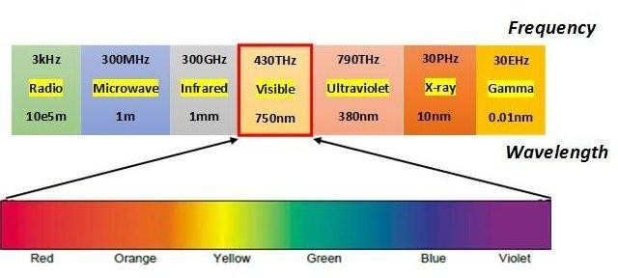
Microwave spectrum
4

Slide 5
MICROWAVE BANDS
Microwave frequency bands
Designation | Frequency range | Wavelength range
L band | 1 to 2 GHz | 15 cm to 30 cm
S band | 2 to 4 GHz | 7.5 cm to 15 cm
C band | 4 to 8 GHz | 3.75 cm to 7.5 cm
X band | 8 to 12 GHz | 25 mm to 37.5 mm
5

Slide 6
K_{u} band | 12 to 18 GHz | 16.7 mm to 25 mm
K band | 18 to 26.5 GHz | 11.3 mm to 16.7 mm
K_{a} band | 26.5 to 40 GHz | 5.0 mm to 11.3 mm
Q band | 33 to 50 GHz | 6.0 mm to 9.0 mm
U band | 40 to 60 GHz | 5.0 mm to 7.5 mm
6

Slide 7
ADVANTAGES OF MICROWAVES
Large Bandwidth: The Bandwidth of Microwaves is larger than the common low frequency radio waves. Thus more information can be transmitted using Microwaves. It is very good advantage, because of this, Microwaves are used for Point to Point Communications.
Better Directivity: At Microwave Frequencies, there are better directive properties. This is due to the relation that As Frequency Increases, Wavelength decreases and as Wavelength decreases Directivity Increases and Beam width decreases. So it is easier to design and fabricate high gain antenna in Microwaves
7

Slide 8
Small Size Antenna: Microwaves allows to decrease the size of antenna. The antenna size can be smaller as the size of antenna is inversely proportional to the transmitted frequency. Thus in Microwaves, we have waves of much higher frequencies and hence the higher the frequency, the smaller the size of antenna.
Low Power Consumption: The power required to transmit a high frequency signal is lesser than the power required in transmission of low frequency signals. As Microwaves have high frequency thus requires very less power.
Effect Of Fading: The effect of fading is minimized by using Line Of Sight propagation technique at Microwave Frequencies. While at low frequency signals, the layers around the earth causes fading of the signal
8

Slide 9
APPLICATIONS OF MICROWAVES
There are many Industrial, Scientific, Medical and Domestic Applications of Microwaves. The great example of Application of Microwaves is 'Microwave Oven' which we uses in our daily life.
Following are the other main application areas of Microwaves:
Communication
Remote Sensing
Heating
Medical Science
9

Slide 10
Communication: Microwave is used in broadcasting and telecommunication transmissions.
As described above, they have shorter wavelengths and allows to use smaller antennas. The cellular networks like GSM, also uses
Microwave frequencies of range 1.8 to 1.9 GHz for communication. Microwaves are also used for transmitting and receiving a signal from earth to satellite and from satellite to earth.
Military or Army also makes use of Microwaves communication system. They uses X or Ku band communication.
in their for their
10

Slide 11
Remote Sensing: Most of you may be familiar with this Application. The most common application of Microwave is its use in RADAR and SONAR.
RADAR is used to illuminate an object by using a transmitter and receiver to detect its position and velocity. Radiometry is also one of the Remote Sensing Applications.
Heating: You all are familiar with this application. We uses Microwave Oven to bake and cook food. It is very convenient electronic machine which performs the heating task very cleanly and in a very less time.
If you Want to know How Does a Microwave Works? then you may wonder that is based on the vibration of electrons present in the Food Particles. That is why Microwave Oven heats the food uniformly without heating the container.
11

Slide 12
Medical Science: Microwave's heating properties are also used in Medical Science. Microwave also have Medical Applications such as it is used in diagnosis and various therapies. There are also some other applications of heating property of microwave such as Drying, Precooking and Moisture Leveling.
12

Slide 13
WAVE GUIDES
A hollow metallic tube of the uniform cross section for transmitting electromagnetic waves by successive reflections from the inner walls of the tube is called as a Waveguide.
Microwaves propagate through microwave circuits, components and devices, which act as a part of Microwave transmission lines, broadly called as Waveguides.
A waveguide is generally preferred in microwave communications. A waveguide is a special form of a transmission line, which is a hollow metal tube. Unlike the transmission line, the waveguide has no center conductor.
13

Slide 14
ADVANTAGES OF WAVEGUIDES
Waveguides are easy to manufacture.
They can handle very large power (in kilowatts)
Power loss is very negligible in waveguides
They offer very low loss ( low value of alpha-attenuation)
The microwave energy when travels through the waveguide, experiences lower losses than a coaxial cable.
14

Slide 15
Types of waveguides
There are five types of waveguides. They are:
Rectangular waveguide
Circular waveguide
Elliptical waveguide
Single ridged waveguide
Double ridged waveguide
15

Slide 16
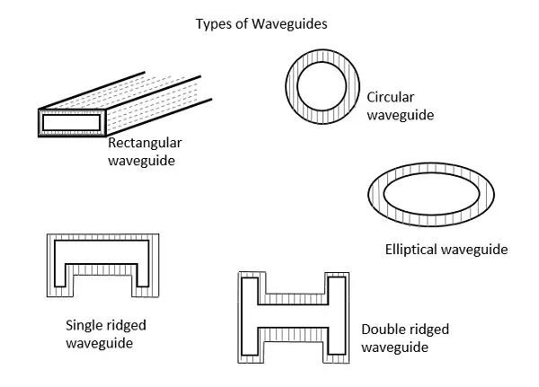
Types of waveguides
16

Slide 17
Transmission Lines | Waveguides
Supports TEM wave | Cannot support TEM wave
All frequencies can pass through | Only the frequencies that are greater than cut-off frequency can pass through
One conductor transmission | Two conductor transmission
Reflections are less | Wave travels through reflections from the walls of waveguide
It has characteristic impedance | It has wave impedance
17

Slide 18
Propagation of waves is according to "Circuit theory" | Propagation of waves is according to "Field theory"
It has a return conductor to earth | Return conductor is not required as the body of the waveguide acts as earth
Bandwidth is not limited | Bandwidth is limited
Waves do not disperse | Waves get dispersed
18

Slide 19
Rectangular Waveguides
Rectangular waveguides are the one of the earliest type of the
transmission lines.
They are used in many applications. A lot of components such as isolators, detectors, attenuators, couplers and slotted lines are available for various standard waveguide bands between 1 GHz to above 220 GHz.
A rectangular waveguide supports TM and TE modes but not TEM waves because we cannot define a unique voltage since there is only one conductor in a rectangular waveguide.
The shape of a rectangular waveguide is as shown below. A material with permittivity e and permeability m fills the inside of the conductor.
19

Slide 20
A rectangular waveguide cannot propagate below some certain frequency. This frequency is called the cut-off frequency.
Here, we will discuss TM mode rectangular waveguides and TE
mode rectangular waveguides separately.
20

Slide 21
Modes of wave guides
Waveguide modes
Looking at waveguide theory it is possible it calculate there are a number of formats in which an electromagnetic wave can propagate within the waveguide. These different types of waves correspond to the different elements within an electromagnetic wave.
TE mode: This waveguide mode is dependent upon the transverse electric waves, also sometimes called H waves, characterized by the fact that the electric vector (E) being always perpendicular to the direction of propagation. In TE wave only the E field is purely transverse to the direction of propagation and the magnetic field is not purely transverse
i.e. Ez=0,Hz#0
21

Slide 22
TM mode: Transverse magnetic waves, also called E waves are characterised by the fact that the magnetic vector (H vector) is always perpendicular to the direction of propagation. In TE wave only the H field is purely transverse to the direction of propagation and the Electric field is not purely transverse
i.e. Ez#0,Hz=0
TEM mode: The Transverse electromagnetic wave cannot be propagated within a waveguide, but is included for completeness. It is the mode that is commonly used within coaxial and open wire feeders. The TEM wave is characterised by the fact that both the electric vector (E vector) and the magnetic vector (H vector) are perpendicular to the direction of propagation. In this neither electric nor magnetic fields are purely transverse to the direction of propagation. i.e. Ez#0, Hz#0
22

Slide 23
Modes
The electromagnetic wave inside a waveguide can have an
infinite number of patterns which are called modes.
The electric field cannot have a component parallel to the surface i.e. the electric field must always be perpendicular to the surface at the conductor.
The magnetic field on the other hand always parallel to the surface of the conductor and cannot have a component perpendicular to it at the surface.
23

Slide 24
We have seen that in a parallel plate waveguide, a TEM mode for which both the electric and magnetic fields are perpendicular to the direction of propagation, exists.
This, however is not true of rectangular wave guide, or for that matter for any hollow conductor wave guide without an inner conductor. We know that lines of H are closed loops.
Since there is no z component of the magnetic field, such loops must lie in the x-y plane. However, a loop in the x-y plane, according to Ampere’s law, implies an axial current.
If there is no inner conductor, there cannot be a real current. The only other possibility then is a displacement current.
24

Slide 25
However, an axial displacement current requires an axial component of the electric field, which is zero for the TEM mode.
Thus TEM mode cannot exist in a hollow conductor. (for the parallel plate waveguides, this restriction does not apply as the field lines close at infinity.)
25

Slide 26
Guided Wavelength (λg)
Guided Wavelength (λg): It is defined as the distance travelled by the wave in order to undergo a phase shift of 2π radians.
It is related to phase constant by the relation λg=2π/β the wavelength in the waveguide is different from the wavelength in free space.
Guide wavelength is related to free space wavelength λ0 and cut-off wavelength
λc by 1/λg²=1/λ0²-1/λc²
The above equation is true for any mode in a waveguide of any cross section
26

Slide 27
Phase Velocity(vp)
Phase Velocity(v_{p}): Wave propagates in the waveguide when guide wavelength λ_{g} is grater than the free space wavelength λ₀.
In a waveguide, v_{p}= λ_{g}f where vp is the phase velocity.
But the speed of light is equal to product of λ₀ and f.
This vp is greater then the speed of light since λ_{g}> λ₀. The wavelength in the guide is the length of the cycle and vp represents the velocity of the phase.
It is defined as the rate at which the wave changes its phase in terms of the guide wavelength.
V_{p}=ω/β
V_{p}=c/[1-(λ₀/λ_{c})²]^{1/2}
27

Slide 28
Degenerate Modes
Degenerate Modes Two or more modes having the same cut-off frequency are called ‘Degenerate modes’
For a rectangular waveguide TE_{mn}/TM_{mn} modes for which both m#0,n#0 will always be degenerate modes.
28

Slide 29
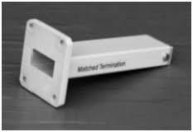
Matched load:
⦿ Matched Load is a device used to terminate a transmission line or waveguide so that all the energy from the signal source will be absorbed.

Slide 30
CIRCUALTORS AND ISOLATORS
⦿ Both microwave circulators and isolators are non reciprocal transmission devices that use the property of Faraday rotation in the ferrite material. A non reciprocal phase shifter consists of thin slab of ferrite placed in a rectangular waveguide at a point where the dc magnetic field of the incident wave mode is circularly polarized. When a piece of ferrite is affected by a dc magnetic field the ferrite exhibits Faraday rotation. It does so because the ferrite is nonlinear material and its permeability is an asymmetric tensor.

Slide 31
MICROWAVE CIRCULATORS
⦿ A microwave circulator is a multiport waveguide junction in which the wave can flow only from the nth port to the (n + I)th port in one direction Although there is no restriction on the number of ports, the four-port microwave circulator is the most common. One type of four-port microwave circulator is a combination of two 3-dB side hole directional couplers and a rectangular waveguide with two non reciprocal phase shifters.

Slide 32
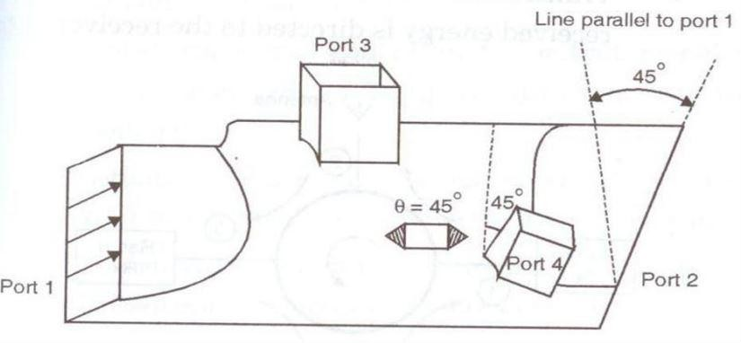
MICROWAVE CIRCULATORS

Slide 33
ISOLATOR
⦿ An isolator is a nonreciprocal transmission device that is used to isolate one component from reflections of other components in the transmission line. An ideal isolator completely absorbs the power for propagation in one direction and provides lossless transmission in the opposite direction. Thus the isolator is usually called uniline.

Slide 34
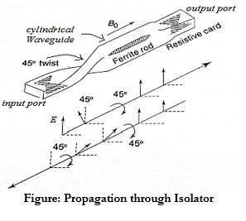

Slide 35
Introduction
Limitations of conventional tubes at microwave frequencies: Conventional vacuum tube like triodes, tetrodes and pentodes are less useful signal source at the frequency above the 300 MHz. To see whether or not a conventional device works satisfactory at high frequencies or microwave frequencies, we consider a simple oscillator having LC tuned circuit and try to increase the operating frequency. For this purpose we reduce the tank circuit parameter, either L or C (since τ
=d/v0). For high frequency or microwave frequency the device parameters like the inter electrode capacitance and lead inductance takes the dominant part in the circuit and affect the operation of the oscillator.

Slide 36
Introduction
There are following reasons for that conventional tube cannot be used for microwave frequency or high frequency.
Inter electrode capacitance and lead inductance effect.
Transit time effect.
Gain-Bandwidth product limitation.
RF losses.
Radiation losses.

Slide 37
Inter electrode Capacitance and Lead Inductance Effect: The inter electrode capacitances and lead inductances are the order of 1 to 2 pF and 15 to 20 mH respectively. The shunt impedances due to inter electrode becomes very low and series impedances due to lead inductance become very high at the microwave or high frequency which makes these tube unstable. Refinements have been done in the design and fabrication of these tubes with the result that these tubes, like disk seal tube, are still used up to the lower end of microwave spectrum.
Transit Time Effect: In a conventional tube electrons emitted by the cathode take a finite (non-zero) time in reaching the anode. This interval, called the transit time, depends on the cathode anode spacing and the static voltage between the anode and the. Transit time (τ) = where τ is the transit time, d is the cathode anode spacing and is the velocity of electrons.

Slide 38
3. Gain-Bandwidth Product Limitation: In ordinary vacuum tubes the maximum gain is generally achieved by resonating the output tunes circuit.
Gain-bandwidth product = Amax BW = (gm/ G) (G/C) Where gm is the transconductance,
Amax·BW = gm/ C .
It is important to note that the gain-bandwidth product is independent of frequency. As gm and C are fixed for a particular tube or circuit, higher gain can be achieved only at the applicable to resonant circuit only.

Slide 39
In microwave device either re-entrant cavities or slow- wave structures are used to obtain a possible overall high gain over a broad bandwidth.
4. RF Losses: RF losses include the skin effect losses and dielectric losses.
(a) Skin effect losses: Due to skin effect, the conductor losses came into play at higher frequencies, at which the current has the tendency to confined itself to a smaller cross-section of the conductor towards its outer surface.

Slide 40
(b)Dielectric losses: At the microwave frequency or high frequency various insulating materials like glass envelope, silicon and plastic encapsulations are used. The losses occur due to dielectric materials is known as dielectric loss generally the relationship between the power loss in dielectric and frequency is given by PL 𝖺 f So, if frequency increases then power loss will also increases. The effect of dielectric loss can reduced eliminating the tube base and reducing the surface area of the dielectric material.
5. Radiation Losses: At high frequency, when the dimensions of wire approaches near to the wavelength (λ = c/f). It will emit radiation called radiation losses. Radiation losses are increases with the increase in frequency. Radiation loss can be reduced by proper shielding of the tube and its circuitry.

Slide 41
Klystron
Klystron is the simplest vacuum tube that can be used for amplification or generation (as an oscillator) of microwave signal. The operation of klystron depends upon velocity modulation which leads to density modulation of electrons. Klystron may be classified as gives below: 1. Two cavity klystron amplifier 2. Multi cavity klystron 3. Reflex klystron.

Slide 42
TWO CAVITY KLYSTRON AMPLIFIER
One of the earlier form of velocity modulation device is the two cavity klystron amplifier, represented by the schematic of figure. It is seen that high velocity electron beam is formed, focused and sent down along a glass tube to a collector electrode, which is at a high positive potential with respect to the cathode. As it is clear from the figure, a two cavity klystron amplifier consists of a cathode, focussing electrodes, two buncher grids separated by a very small distance forming a gap A (Input cavity or buncher cavity), two catcher grids with a small gap B (output or catcher cavity) followed by a collector.

Slide 43
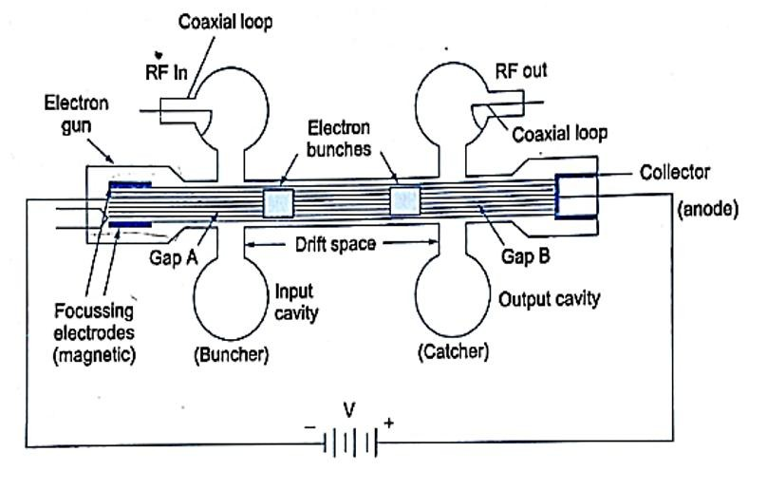
Figure

Slide 44
Operation
The input and output are taken from the tube is via resonant cavity with the help of coupling loops. The region between buncher cavity and catcher cavity is called drift space. The first electrode (focussing grid) controls the number of electrons in the electron beam and serves to focus the beam. The velocity of electrons in the beam is determined by the beam accelerating potential. On leaving the region of focussing grid, the electrons passes through the grids of buncher cavity. The space between the grids is referred to as interaction space.
When electrons travel through this space, they are subjected to RF potential at a frequency determined by the cavity resonant frequency which is nothing but the input frequency.

Slide 45
Operation
The amplitude of this RF potential between the grids is determined by the amplitude of the input signal in case of an amplifier or by the amplitude of feedback signal from the second cavity if used as an oscillator. The working of two cavity klystron amplifier depends upon velocity modulation.

Slide 46
Velocity Modulation Consider a situation when there is no voltage across the gap. Electrons passing through gap A are unaffected and continue on to the collector with the same constant velocities they had before approaching the gap A. When RF signal to be amplified is used for exciting the buncher cavity thereby developing an alternating voltage of signal frequency across the gap A. The theory of velocity modulation can be explain by using the diagram known as Applegate diagram as shown in figure. At point X on the input RF cycle, the alternating voltage is zero and electron which passes through gap A is unaffected by the RF signal

Slide 47
Let this electron is called reference electron eR which travels with an unchanged velocity , where V is the anode to cathode voltage. Consider another point Y of the RF cycle an electron passing the gap slightly later than the reference electron eR, called the late electron eL is subjected to positive RF voltage so late electron eL is accelerated and hence travelling towards gap B with an increased velocity and this late electron eL tries to catch the reference electron eR. Similarly, another point Z of RF cycle, an electron passing the gap slightly before than the reference electron eR, called the early electron ee and this early electron is subjected to negative RF voltage so early electron ee is retarded and hence travelling towards gap B with reduced velocity and reference electron eR catches up the early electron ee.

Slide 48
So, when the electron pass through the buncher gap their velocity will be change according to the input RF signal. This process is known as velocity modulation.

Slide 49
Applegate diagram, the electrons gradually bunch together as they travel in the drift space. When an electron catches up with another one, the electron will exchange energy with the slower electron, giving it some excess energy and they bunch together and move on with the average velocity of the beam. This phenomena is very vital to the operation of klystron tube as an amplifier. The pulsating
stream of electrons passes through gap B and
excited oscillation in the output cavity. The density of electron
passing the gap B varies cyclically with time. This mean the electron beam contains an AC current and variation in current density (often called current modulation) enables the klystron to have a significant gain and hence drift space converts the velocity modulation into current modulation.

Slide 50
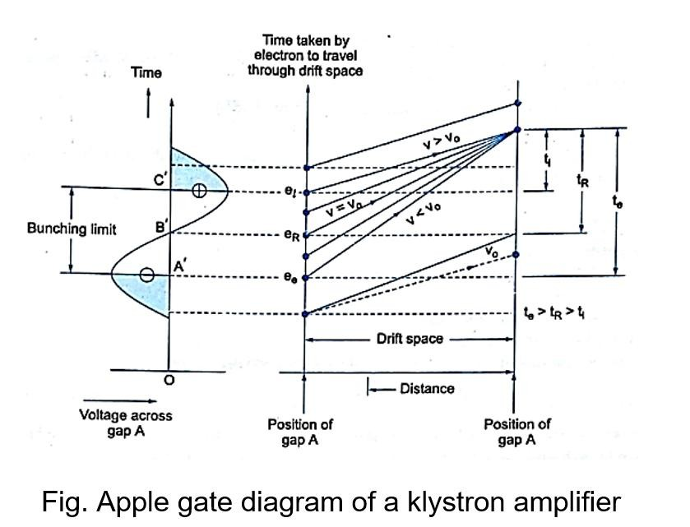

Slide 51
Bunching process
The electrons gradually bunch together due to the difference in velocities of the electrons, as they travel down the drift space. The variation in electron velocity in drift space is known as velocity modulation and the density of electrons in the bunches and catcher cavity gap varies cyclically with time,
i.e. become density modulated.
According to fig. the distance from buncher grid to the buncher location is ΔL and initially we consider for electron B,

Slide 52
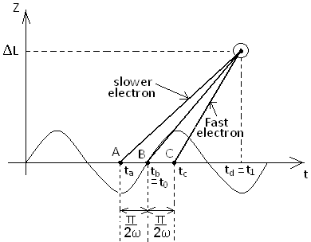

Slide 53
Output Power and Efficiency
The electronic efficiency of the two cavity klystron amplifier is defined as the ratio of the output power to the input power
Efficiency ‘η’ = P₀/P_{in} = P_{ac}/P_{dc}
From previous equations, η = (0.58). V₂ /V₀
and the voltage V₂ is equal to V₀, then maximum efficiency η_{max} = 58% But in practice the efficiency is in the range of 15 to 40%.

Slide 54
Multi cavity Klystron amplifier
Klystron amplification, power output, and efficiency can be greatly improved by the addition of intermediate cavities between the input and output cavities of the basic klystron. Additional cavities serve to velocity-modulate the electron beam and produce an increase in the energy available at the output. Since all intermediate cavities in a multi cavity klystron operate in the same manner, a representative three-cavity klystron will be discussed.

Slide 55
Multi cavity klystron amplifier
Construction: A three-cavity klystron is illustrated in figure. The entire drift-tube assembly, the three cavities, and the collector plate of the three-cavity klystron are operated at ground potential for reasons of safety. The electron beam is formed and accelerated toward the drift tube by a large negative pulse applied to the cathode. Magnetic focus coils are placed around the drift tube to keep the electrons in a tight beam and away from the side walls of the tube. The focus of the beam is also aided by the concave shape of the cathode is high-powered klystrons.

Slide 56
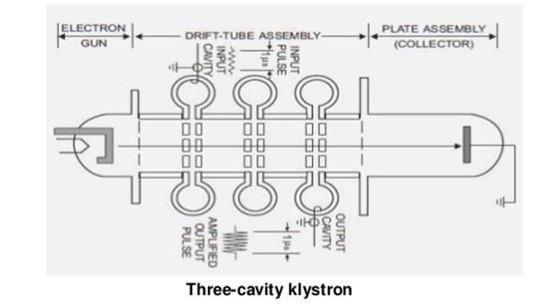
Figure

Slide 57
Operation of Multi cavity Klystron
The output of any klystron (regardless of the number of cavities used) is developed by velocity modulation of the electron beam. The electrons that are accelerated by the cathode pulse are acted upon by RF fields developed across the input and middle cavities. Some electrons are accelerated, some are decelerated, and some are unaffected. Electron reaction depends on the amplitude and polarity of the fields across the cavities when the electrons pass the cavity gaps. During the time the electrons are travelling through the drift space between the cavities, the accelerated electrons overtake the decelerated electrons to form bunches. As a result, bunches of electrons arrive at the output cavity at the proper instant during each cycle of the RF field and deliver energy to the output cavity. Only a small degree of bunching takes place within the electron beam during the interval of travel from the input cavity to the middle cavity.

Slide 58
The amount of bunching is sufficient, however, to cause oscillations within the middle cavity and to maintain a large oscillating voltage across the middle cavity gap. Most of the velocity modulation produced in the three-cavity klystron is caused by the voltage across the input gap of the middle cavity. The high voltage across the gap causes the bunching process to proceed rapidly in the drift space between the middle cavity and the output cavity. The electron bunches cross the gap of the output cavity when the gap voltage is at maximum negative.

Slide 59
Maximum energy transfer from the electron beam to the output cavity occurs under these conditions. The energy given up by the electrons is the kinetic energy that was originally absorbed from the cathode pulse. Klystron amplifiers have been built with as many as five intermediate cavities in addition to the input and output cavities. The effect of the intermediate cavities is to improve the electron bunching process which improves amplifier gain. The overall efficiency of the tube is also improved to a lesser extent.

Slide 60
Reflex Klystron
Reflex klystron is low power, low efficiency microwave oscillator. Reflex klystron is a single cavity variable frequency microwave generator. This is most widely used in application where variable frequency is desired like radar receiver and microwave receivers. Construction: Reflex klystron consists of an electron gun similar to that of multi cavity klystron, a filament surrounded by a cathode and a focussing electrode at the cathode as shown in figure. The reflex klystron contains a repeller which is at a high negative potential.

Slide 61
Reflex Klystron
The suitable formed electron beam is accelerated towards the cavity, where a high positive voltage applied to it. This acts as anode and known as anode cavity. After passing the gap in cavity electrons travel towards repeller which is at high negative potential. The electrons are repelled back from midway of the repeller space by the repeller electrode towards the anode. If conditions are properly adjusted, then the returning electrons give more energy to the gap than they took from it on forward journey, thus leads to sustained oscillations.

Slide 62
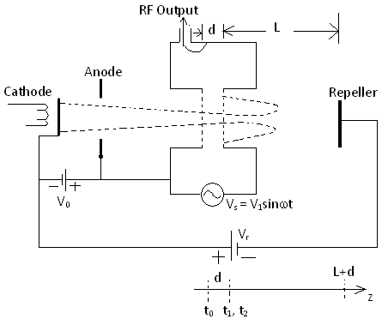

Slide 63
Where, t₀ = time for electron entering cavity gap at z = 0
t₁ = time for same electron leaving cavity gap at z = d
t₂ = time for same electron returned by retarding field z=d and collected on walls of cavity.
Operation- The electron beam injected from the cathode is first velocity modulated by the beam voltage. Some electrons are accelerated and leave the resonator at an increased velocity than those with uncharged velocity. Some retarded electrons enter the repeller region with less velocity. Then the electrons, which are leaving the resonator, will need different time to return due to change in velocity. As a result returning electrons group together in bunches. It is seen that earlier electrons take more time to return to the gap than later electrons and so the conditions are right for bunching to take place.

Slide 64
On their return journey the bunched electrons pass through the gap during the retarding phase of the alternating field and give up their Kinetic energy to the e.m. energy of the field in the cavity.
Or as the electron bunches pass through resonator, they interact with voltage at resonator grids. If the bunches pass the grid at such time that the electrons are slowed down by the voltage, energy will be delivered to the resonator and electrons will oscillate. The electrons finally collected by the walls of the cavity or other grounded metal parts of the tube.

Slide 65
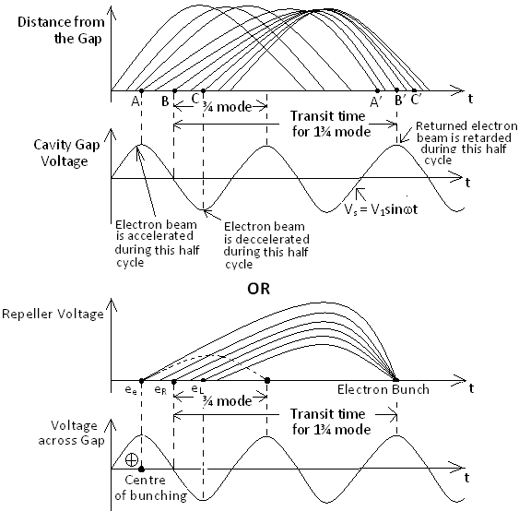
Applegate diagram

Slide 66
Operation through Applegate diagram- The early electron e_{e} that passes through the gap, before the reference electron e_{R}, experiences a maximum +ve voltage across the gap and the electron is accelerated, it moves with greater velocity and penetrates deep into repeller space. The return time for electron e_{e} is greater as the depth of penetration into the repeller space is more. Hence e_{e} and e_{R} appear at the gap fpr second time at the same instant.

Slide 67
The late electron e_{L} that passes the gap, later than reference electron e_{R}, experiences a maximum –ve voltage and moves with a retarding velocity. The return time is shorter as the penetration into repeller space is less and catches up with reference electron e_{R} and earlier electron e_{e} and forming a bunch.
Bunches return back and pass through the gap during the retarding phase of the alternating field and give up their maximum energy to the e.m. energy of the field in the cavity to sustained oscillations.

Slide 68
Travelling wave tube
Travelling wave tube has been designed for frequencies as low as 300 MHz and high as 50 GHz. The wide bandwidth and low- noise characteristics makes the TWT ideal for used as an amplifier in microwave equipment. For broadband application, such as satellite, radar transmitter, the TWT are almost exclusively used. If we compare the basic operating principles of TWT and klystron, in TWT, the microwave circuit is non-resonant and the wave propagates with same speed as the electrons in the beam. The initial effect on the beam is a small amount of velocity modulation caused by the weak electric field associated with the travelling wave. Just as in the klystron this velocity modulation later translates to current modulation, which then induces on RF current in the circuit, causing amplification.

Slide 70
Operation
The applied RF signal propagates around the turns of the helix, and it produces an electric field at the centre of the helix. The axial electric field propagates with velocity of light multiplied by the ratio of the helix pitch to helix circumference. When the electrons enter the helix tube, an interaction takes place between the moving axial electric field and the moving electrons.
The interaction takes place between them in such a way that on an average the electron beam delivers or transfer energy to the RF wave on the helix. This interaction causes the signal wave grows amplified and becomes larger.

Slide 71
Velocity Modulation- When the axial field is zero, electron velocity is unaffected. This happens at the point of node of the axial electric field. Those electrons entering the helix, when the axial field is positive antinode, at the accelerating field are accelerated. At a later point where the axial RF field is –ve antinode, retarding field, the electrons are decelerated. The electrons get velocity modulated.
As the electrons travel further along the helix, bunching of electrons occur at the end which shifts the phase of π/2. Magnet produces axial magnetic field prevents spreading of electron beam as it travels down the tube.

Slide 72
Slow Wave Structures (SWS)
SWSs are special circuits which are used in microwave tubes to reduce the velocity of wave in a certain direction so that the electron beam and the single wave can interact.
The phase velocity of a wave in ordinary waveguide is greater than the velocity of light in a vacuum. Since the electron beam can be accelerated only to velocities that are about a fraction of the velocity of light, thus the electron beam must keep in step with the microwave signal and a slow wave structure must be incorporated in the microwave devices. By which electron beam and signal wave are travelling with nearly the same velocity and valuable interaction takes place.

Slide 73
Slow Wave Structures (SWS)
As the operating frequency is increased, both the inductance and capacitance of the resonant circuit must be decreased in order to maintain resonance at operating frequency. Because the gain bandwidth product is limited by the resonant circuit, the ordinary resonator cannot generate a large output. Several non-resonant periodic circuits or slow wave structures are designed for producing large gain over a wide bandwidth

Slide 74
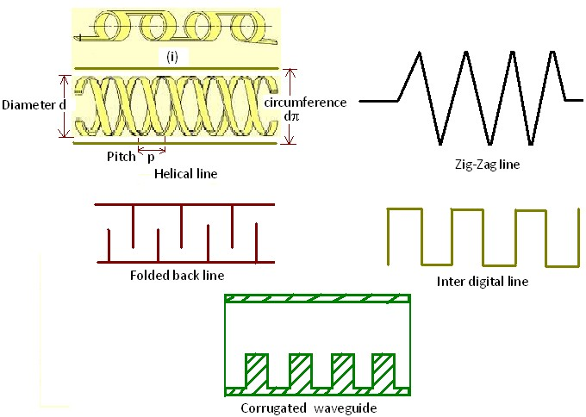

Slide 75
Convection Current
The convection current induced in the electron beam by the axial electronic field and the microwave axial field produced by the beam must first be developed? When the space charge effect is considered the electron velocity, charge density, current density and axial electric field will perturbrate about their average DC values.
The schematic diagram and simplified circuit of helix TWT are shown below

Slide 76
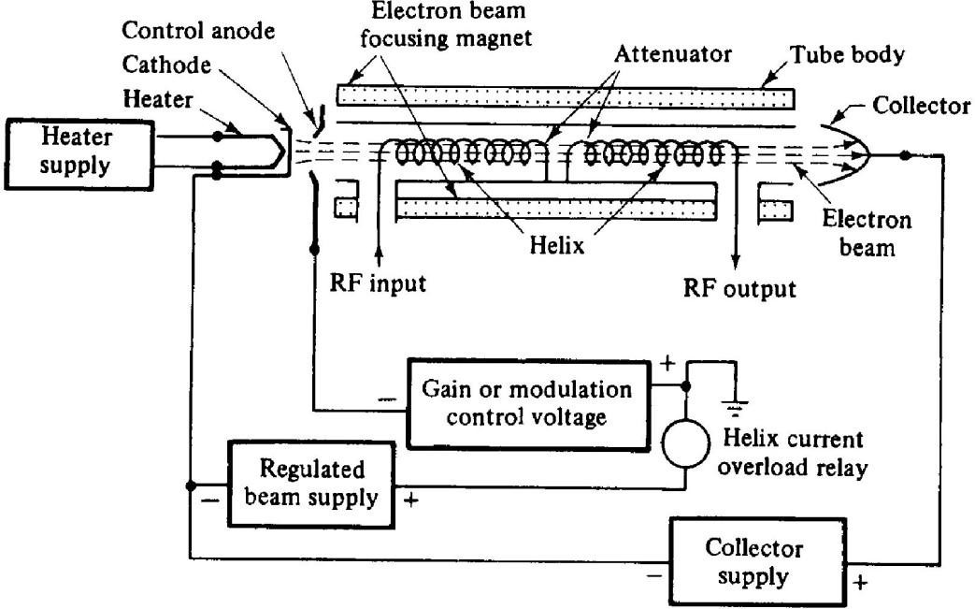

Slide 77
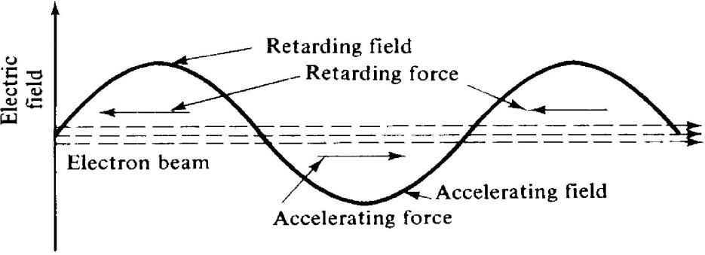
The electrons entering the retarding field are decelerated and those in the accelerating field are accelerated. They begin forming a bunch centred about those electrons that enter the helix during the zero fields

Slide 78
Since the dc velocity of the electrons is slightly greater than the axial wave velocity, more electrons in the retarding field than in the accelerating field, and a great amount of energy is transferred from the beam to the electromagnetic field. The microwave signal voltage is amplified by the amplified field
The bunch continues to become more compact, and a larger amplification of the signal voltage occurs at the end of the helix. The magnet produces an axial magnetic field to prevent spreading the electron beam as it travels down the tube.

Slide 79
An attenuator placed near the centre of the helix reduces all the waves travelling along the helix to nearly zero so that the reflected waves from the mismatched loads can be prevented from reaching the input and causing oscillation. The bunched electrons emerging from the attenuator induce a new electric field with the same frequency. This field in turn induces a new amplified microwave signal on the helix. The magnitude of the velocity fluctuation of the electron beam is directly proportional to the magnitude of the axial electric field

Slide 80
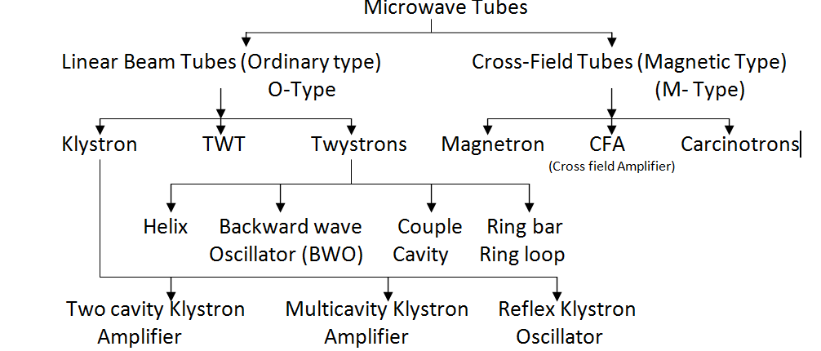
Cross-Coupled Tubes (Magnetron Oscillator)

Slide 81
Mechanism of oscillations in Magnetron- The magnetron requires an external magnetic field with flux lines parallel to the axis of cathode. This field is provided by a permanent magnet or electromagnet. The dc magnetic field is normal to the dc electric field between the cathode and anode. Because of the cross-field between the cathode and anode, the electrons emitted from the cathode are affected by the cross-field to move in curved paths. If the dc magnetic field is strong enough, the electrons will not arrive in the anode but return back to the cathode.

Slide 82
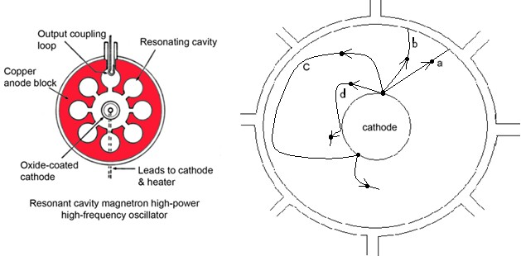

Slide 83
Operation- From fig (b).
Path ‘a’- If there is no magnetic field present; the electron would be drawn directly towards the anode in accordance with path ‘a’.
Path ‘b’- As the electron travels with a velocity the axial magnetic field exerts a force on it. When the magnetic field is weak the electron path is deflected as path ‘b’.
Path ‘c’- However, when the intensity of the magnetic field is sufficiently great, the electrons are turned back towards the cathode without ever reaching the anode accordance with path ‘c’.
path ‘d’- The magnetic field which is just able to return the electrons back to the cathode before reaching the anode, is termed the cut-off field as shown in path ‘d’.
Thus when the magnetic field exceeds the cut-off value, then in the absence of oscillations all the emitted electrons return to the cathode and the plate current is zero.

Slide 84
π-Mode Oscillations
Let the cavity magnetron has 8 cavities, by which it supports varieties of modes depending upon the phase difference between fields in two adjacent cavities. Boundary conditions are satisfied when total phase shift around the eight cavities is multiplied by 2π radians. However, the most important mode for magnetron operation is one where in the phase shift between the fields of adjacent cavities is π radians. This is known as π-Mode.

Slide 85
Microwave Solid State Devices
Introduction
Special electronics effects encountered at microwave frequencies severely limit the usefulness of transistors in most circuit applications.
Using vacuum tubes for low power applications become impractical.
Need for small sized microwave devices has caused extensive
research in this area
This research has produced solid-state devices with higher and higher frequency ranges.
The new solid state microwave devices are predominantly active, two terminal diodes, such as tunnel diodes, varactors, transferred-electron devices, and avalanche transit-time diodes

Slide 86
TRANSFERRED ELECTRON DEVICES.
⦿ Transferred electron devices (TED’s) are bulk semiconductor devices having no junction.
⦿ TED’s are fabricated from compound semiconductor such as GaAs (gallium arsenide),
⦿ TED’s operate with hot electrons whose energy is very much greater than the thermal energy.
⦿ the current in the specimen become a fluctuating function of time.
⦿ Then negative resistance will manifest itself under certain conditions. Oscillations will occur if the GaAs specimen is connected to a suitable tuned circuit.
⦿ It is seen that the voltage across the GaAs is very high and
electron velocity is also high,

Slide 87
TWO VALLEY THEORY (RWH THEORY)
the two-valley model, however, there are two regions in the conduction band in which charge carriers (electrons) can exist. These regions are called valleys and are designated the upper valley and lower valley. According to the RWH theory, electrons in the lower valley have low effective mass (0.068) and consequently a high mobility (8000 cm2/V-s). In the upper valley, which is separated from lower valley by potential of 0.36 eV, electrons have a much higher effective mass (1.2) and lower mobility (180 cm2/V- s) than in the lower valley.
Basic mechanism involved in the operation of bulk n-type GaAs devices is the transfer of electrons from lower conduction valley to the upper conduction valley. Electron density thus in lower valley and upper valley remain the same under equilibrium conduction.

Slide 88
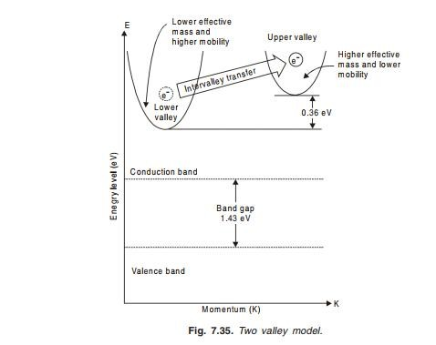
Two valley model.

Slide 89
Two valley model.
When E < El
When the applied electric field is lower than the electric field of the lower valley (E < El), then electrons will occupy states in the lower valley Thus the material is in the highest average velocity state (electron in lower valley has high mobility) and drift velocity increases linearly with increasing potential. Thus increasing the current density J and hence positive differential resistance (ohmic region).
RWH theory is based on population inversion principle.
When El < E < Eu
As the applied field is increased (2–4 kV/cm) higher than that of the lower valley and lower than that of the upper valley (El < E < Eu), electrons will gain energy from it and move upward to upper valley As the electrons transfer to the upper valley, their mobility decreases and the effective mass is increased thus decreasing the current density J and hence negative differential resistivity.

Slide 90
Transfer of electron densities.

Slide 91
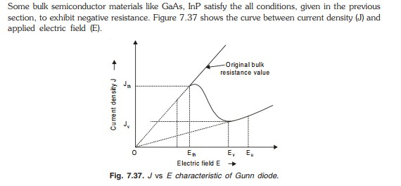
Characteristics of Gunn Diode

Slide 92
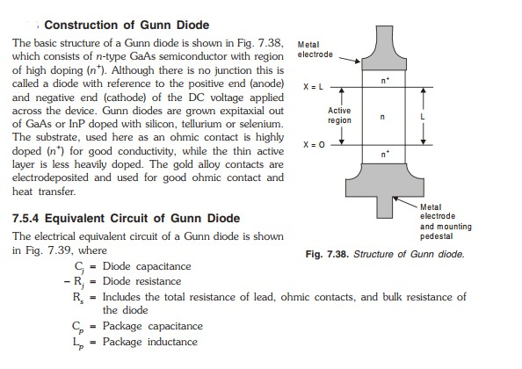
Construction of Gunn Diode

Slide 93
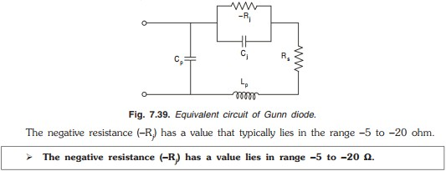
Equivalent Circuit of Gunn Diode
Domain Mode:

Slide 94
Disadvantages of Gunn Diode
Gunn diode is very much temperature dependent i.e., a frequency shift of 0.5 to 3 MHz per °C.
By proper design this frequency shift can be reduced to 50 kHz for a range of - 40°C to 70°C.
Other disadvantages of Gunn diode is, the power output of the
Gunn diode is limited by difficulty of heat dissipation from the
small chip.
Gunn diode is very much temperature dependent.

Slide 95
Applications of Gunn Diode
Gunn diode can be used as an amplifier and as an oscillator. The applications of Gunn diode are
In broadband linear amplifier.
In radar transmitters.
Used in transponders for air traffic control.
In fast combinational and sequential logic circuit.
In low and medium power oscillators in microwave receivers.

Slide 96
Comparison Between Microwave Transistors and TED’s
Microwave transistors
1.Operate with junction or gates. 2.Fabricated from elemental semiconductors such as Si or Ge.
3.Operate with warm electrons whose energy is not much greater than their thermal energy (0.026 eV at room temperature).
TED’s
Operate with bulk devices having no junctions and gates. Fabricated from compound GaAs, CdTe or InP.
Operate with hot electrons whose energy is very much greater than the thermal energy

Slide 97
AVALANCHE TRANSIT TIME DEVICES
In 1958, Read at Bell Telephone Laboratories proposed that the delay between voltage and current in an avalanche,
together with transit time through the material, could make a microwave diode exhibit negative resistance such devices are called Avalanche transit time devices.
The prominent members of this family include the IMPATT and TRAPATT diode.
IMPATT (Impact Ionization Avalanche Transit Time) diode as the name suggests, utilizes impact ionization for carrier generation.
TAPATT (Trapped Plasma Avalanche Triggered Transit Time) diode is derived from the IMPATT with some modifications in the doping profiles so as to achieve higher pulsed microwave powers
at better efficiency values.

Slide 98
IMPATT DIODE
The IMPATT diode or IMPact Avalanche Transit time diode is an RF semiconductor device that is used for generating microwave radio frequency signal, with the ability to operate at frequencies between about 3 to 100 GHz or more, one of the main disvantages is the relatively high power capability of the IMPATT diode.
IMPATT Structures
There is a variety of structures that are used for the IMPATT diode like p+nin+ or n+pip+ read evice, p+nn+, and p+in+ diode, all are variations of a basic pn junction
IMPATT diode is semiconductor device which generate microwave signal from 3 to 100 GHz.
In IMPATT diode, negative resistance effect phenomenon is taken
into account

Slide 99
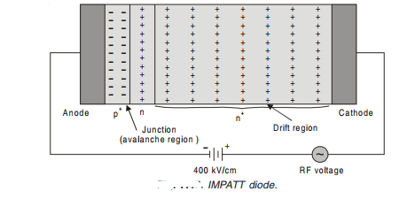
Operation of IMPATT
A cross-section of p+n n+ IMPATT diode structure is shown in Fig.
7.47. Note that it is a diode,the junction being between p+ and then n layer.
An extremely high voltage gradient is applied in reverse bias to
the IMPATT
diode, of the order of 400 kV/cm,
in very
eventually
current.
resulting
high

Slide 100
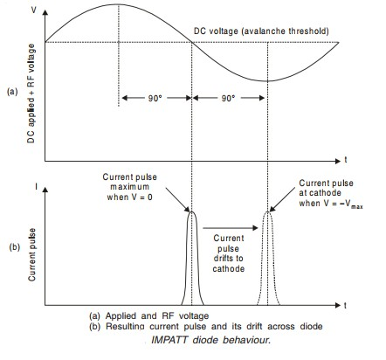
Operation of IMPATT
Such a high potential gradient, back-biasing the diode, causes a flow of minority carriers across the junction. If it is now assumed that oscillations exist.
Now we may consider the effect of a positive swing of the RF voltage superimposed on top of the high DC voltage

Slide 101
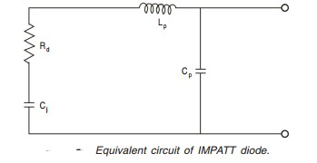
Equivalent Circuit of IMPATT
A simplified equivalent circuit for IMPATT diode chip is shown in Fig.
Typically negative resistance varies between -0.7 Ω and -2 Ω, and capacitance ranges from 0.2 to 0.6 pF.
where
Rd = Diode negative resistance consisting of the series lead resistance Rs and the negative resistance - Rj due to impact avalanche process. Cj= Junction capacitance.
Lp= Package lead inductance. Cp= Package lead capacitance.

Slide 102
Advantages of IMPATT Diode
IMPATT diodes are at present the most powerful solid-state microwave power sources. Some of the major advantages of
IMPATT diode
1. Higher operating range are obtain (up to 100
are:
GHz).
2. Above about 20 GHz, the IMPATT diode produces a higher CW power output per unit than any other semiconductor device.
Higher operating range (up to 100 GHz) can be obtained from IMPATT diode.

Slide 103
Disadvantage of IMPATT Diode
The major disadvantages of IMPATT diode are:
Since DC power is drawn due to induced electron current in the external circuit, IMPATT diode has low efficiency (RF power output/DC input power).
Tend to be noisy due primarily to the avalanche process and to the high level of operating current. A typical noise figure is 30 dB
which is worse than
that of compare to
Gunn Gunn
diode. diode.
3. Tuning is difficult as
4. To run an IMPATT diode, a relatively high voltage is required.

Slide 104
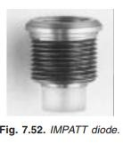
Applications of IMPATT Diode
IMPATT diodes are used as microwave oscillators such as:
Used in final power stage of solid state microwave transmitter for communication purpose.
Used in transmitter of TV system.
Used in FDM/TDM system.
Used in microwave source in laboratory for measurement purpose.
Photograph of a IMPATT diode is shown in Fig. 7.52.

Slide 105
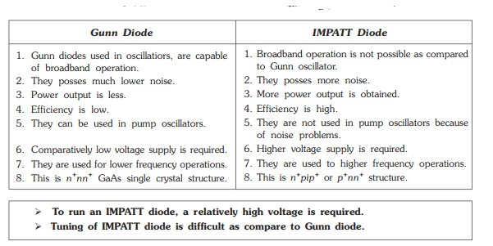
Comparison between Gunn diode and Impatt diode

